Slide 1
Mini project 1
Heart Failure clinical records
Submitted by TANU ROY, DBA20013

Slide 2
Data source
We got the Heart Failure Clinical Records data from UCI Machine Learning Repository.
http://archive.ics.uci.edu/ml/datasets/Heart+failure+clinical+records

Slide 3
Problem statement
Heart Failure Clinical Records data has the records of 300 patients with 12 Attributes from which we will be visualising the AGE factor & Blood Platelet Counts to the dependent variable Death Events in order to get a clear image about the relations between them.

Slide 4
goal
Our Objective is to create a view based on the data with the help of Fusion chart or
Plotly to get a clear picture about the data. We will be using Pie chart in Jsfiddle and
procure the chart to explain.
In the first plot which is Pie chart , I have categorized data for the Age factor and plot it with the total death event.
Similarly I will creating the second chart, the Line graph by categorizing the age and plot it with the Blood Platelet count.

Slide 5
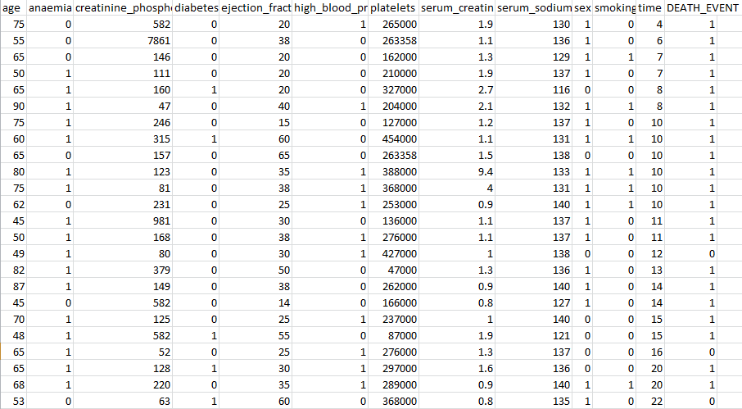
Summary table

Slide 6
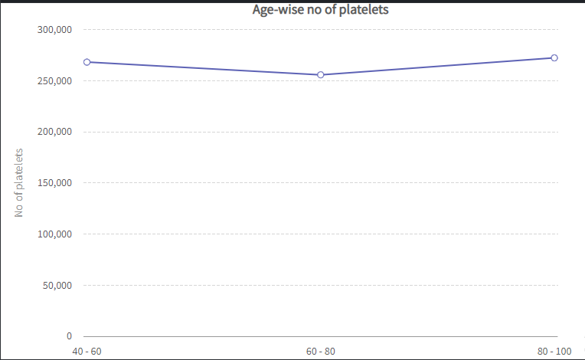
Chart 1

Slide 7
conclusion
This Line Graph shows the Blood Platelets count among the age group between 40-60, 60 -80 and 80-100.
The Graph shows that the Platelets are decreasing in the group of 60-80 aged people. Hence The Patient should be more careful if they are likely to have all the other factors affecting their health.
The Data shows the Age group between 40-60 & 80-100 are quite stable with the platelet count of 270,000

Slide 8
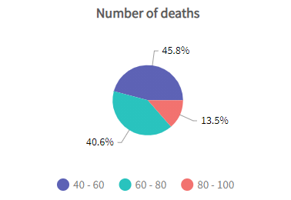
Chart 2

Slide 9
conclusion
The Graph is all about the Number of Death is in a Pie Chart where the age group is
categorized.
We infer from this chart that 40.6% people are dying between the age group 40-60,
45.8% people are dying between the age group 60-80. 13.5% people are dying
between the age of 60-80. So 60-80 age group people has more chances of getting
heart failure.

